Slide 1
Adding protein-ligand interaction descriptors
Team 3A
Team Lead: Ravi Abrol
Email: abrol@csun.edu

Slide 2
Team 3A
Sreeranjini Babu
Sridhar Malkaram
Aaron Ayllon-Benitez
Rachita K Kumar
Sangram Keshari Sahu
Ravi Abrol

Slide 3
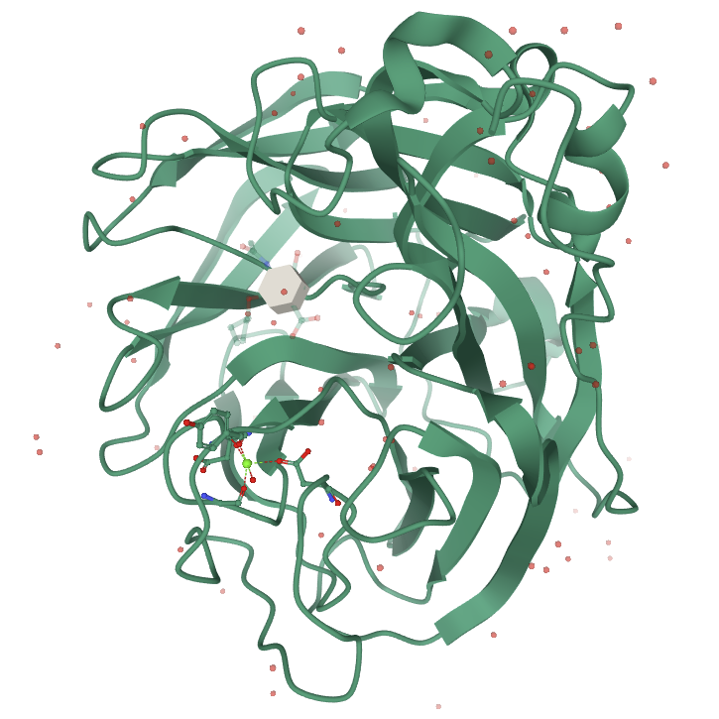
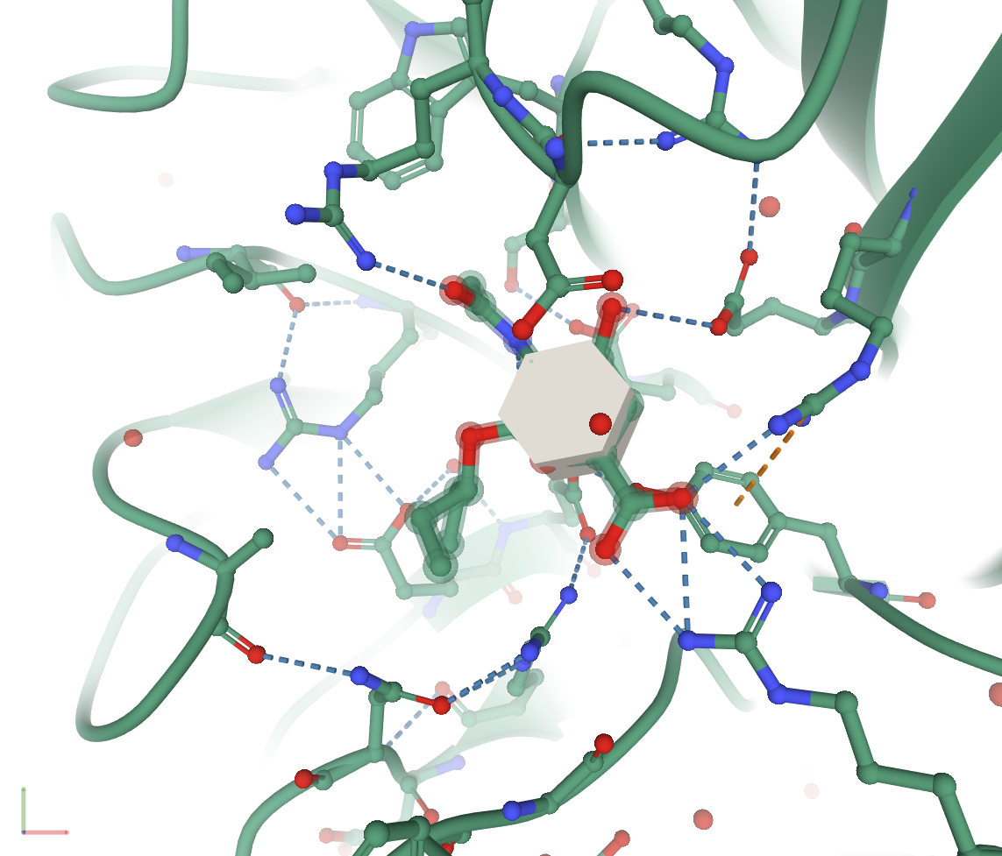
Structure of an anti-viral compound bound to influenza virus protein

Slide 4
Protein-Ligand Interactions
Overall GOAL:
Analyze PDB structures of ligands bound to proteins using PLIP server in terms of:
hydrogen bonds
water bridges
salt bridges
halogen bonds
hydrophobic interactions
π-stacking
π-cation interactions
metal complexes

Slide 5
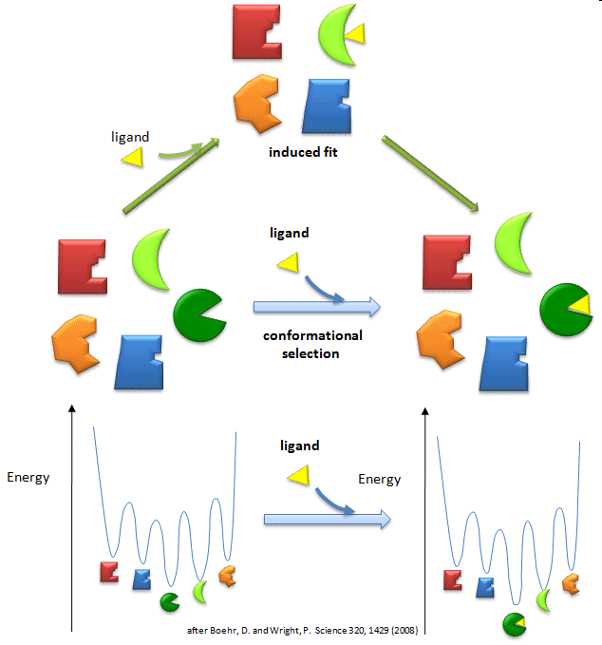
Protein-Ligand Interactions
Multiple Lock – Multiple Key Model
(Conformational Selection)
Protein conformations
Ligand conformations
Conformational selection
leads to binding
AND / OR
Induced Fit Model
Flexible protein
Flexible ligand
Loose fit induces mutual
conformational change for
strong binding

Slide 6
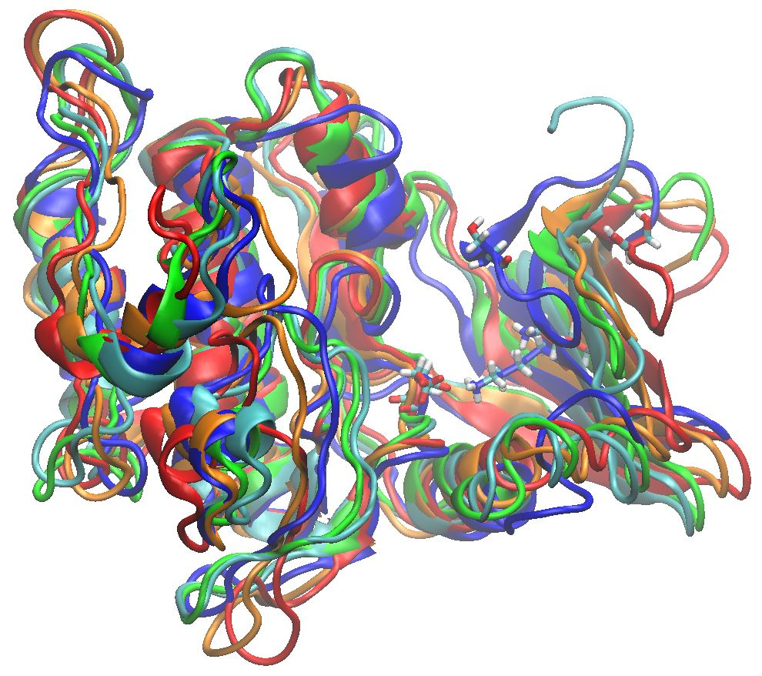
Protein Backbone Flexibility
A Protein Kinase in Multiple Conformations
Ser591
Lys612
Asp727
Glycine-rich Loop

Slide 7
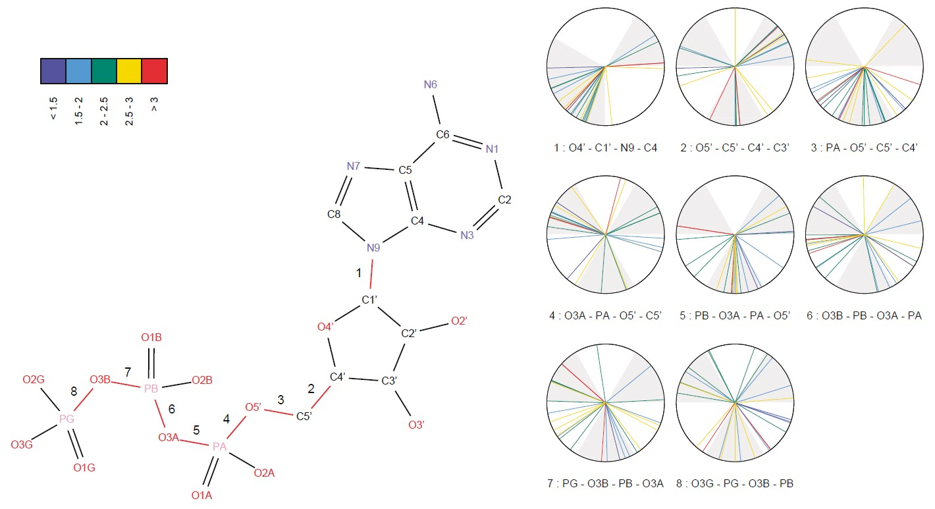
Ligand Conformational Flexibility
Torsional preferences for rotatable bonds in ATP using
27 diverse conformations based on 407 co-crystals.
[Stockwell and Thornton (2006), J. Mol. Biol. 356, 928]

Slide 8
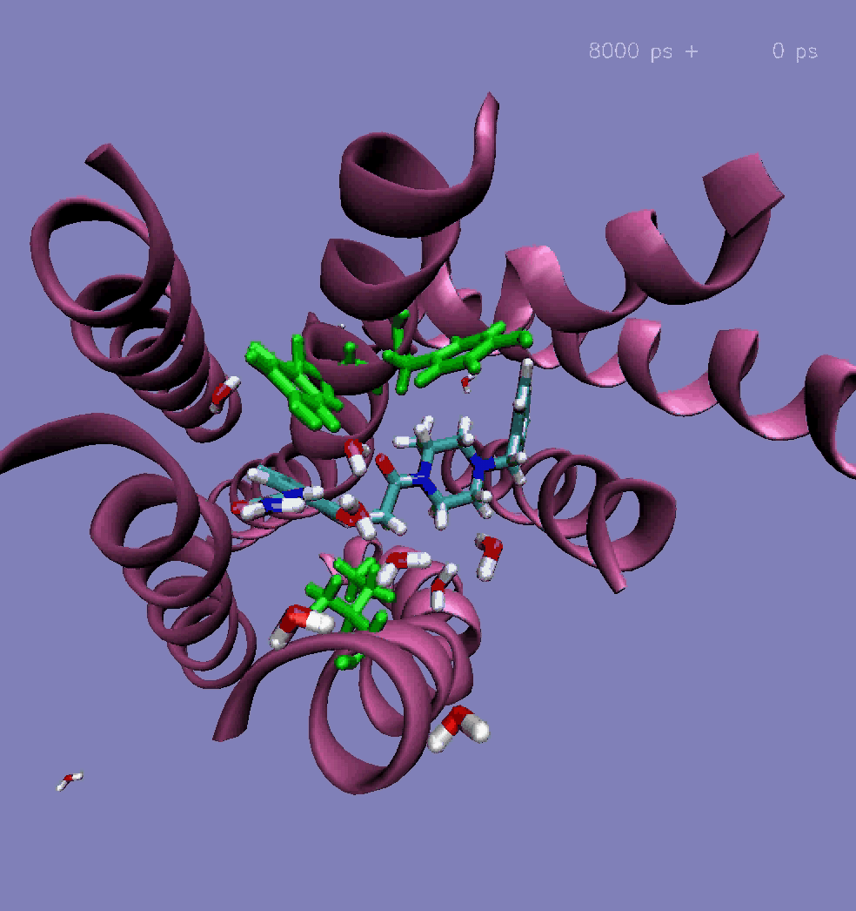
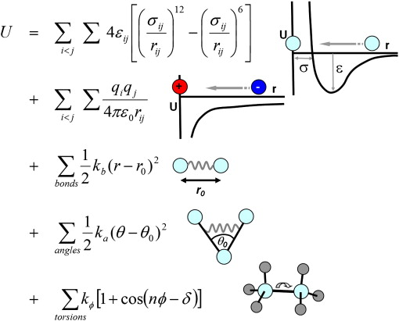
Scoring of Protein-Ligand Complexes May the Force-Field Be With You!
Source: Adv Drug Del Rev
Force Fields: Energy expressions that allow the
efficient calculation of interatomic forces. E.g.,
CHARMM, AMBER, OPLS, Dreiding, GROMOS
Vaidehi et al. (2006) J Biol Chem,281:27613.

Slide 9
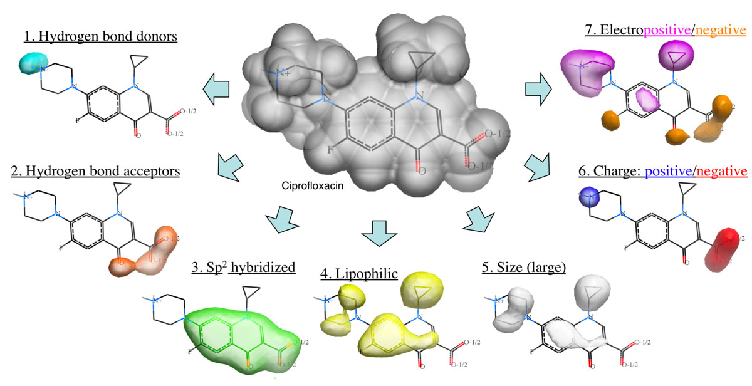
Drug Discovery: Ligand Structure Based Methods

Slide 10
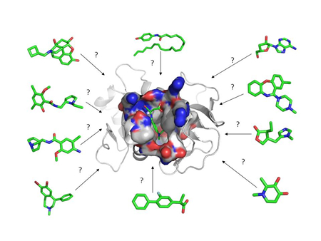
Protein Structure Based Methods
http://blaster.docking.org, AUTODOCK VINA, etc

Slide 11
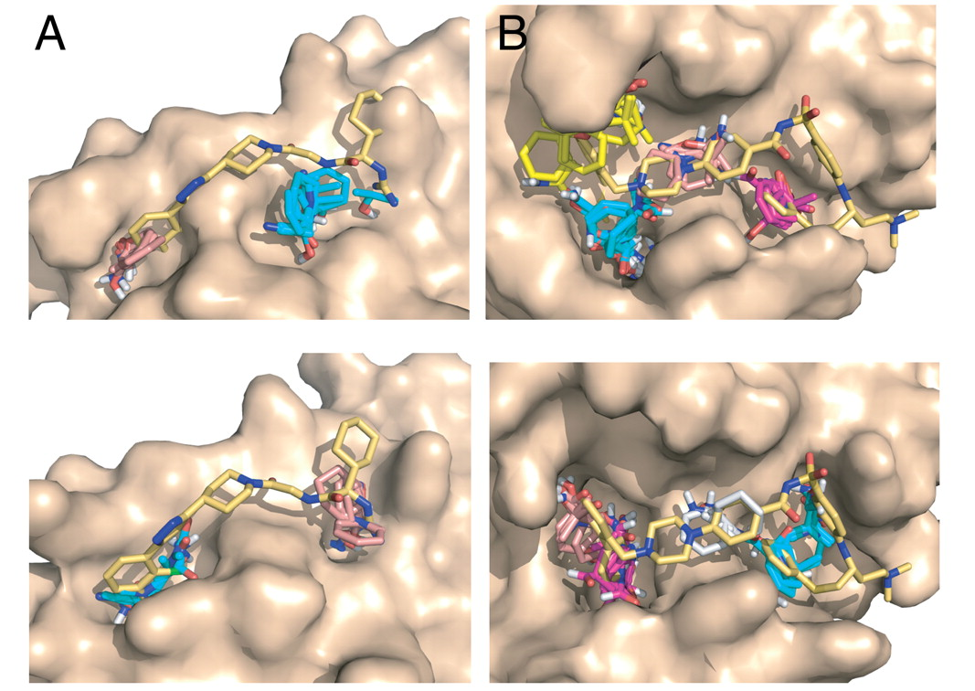
Hybrid Approaches
21808046
Hot spot mapping results
Can also used to assess druggability
IL-2 Bcl-xL
Kozakov et al. PNAS (2011); PMID=21808046

Slide 12
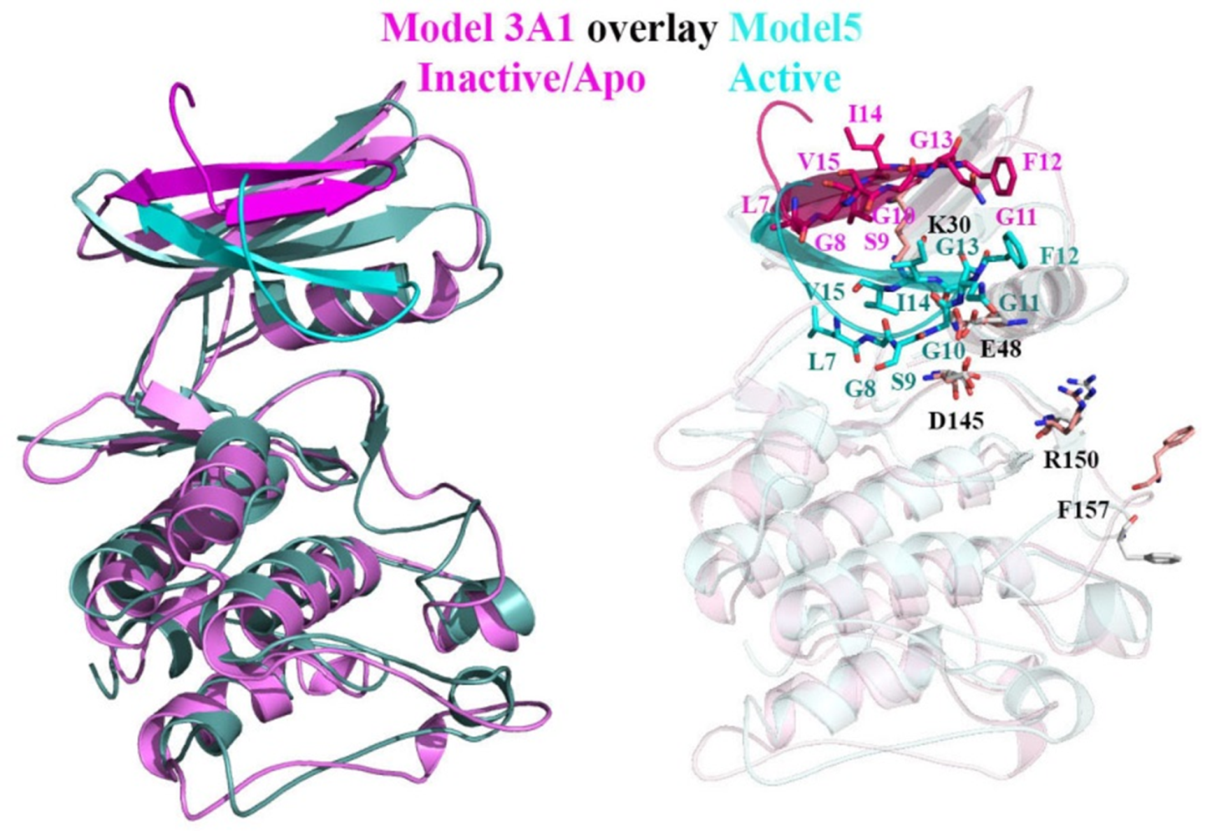
A Kinase Example
If a ligand binds to more than one protein or two different protein conformations:
A differential Protein-Ligand interaction map can help.

Slide 13
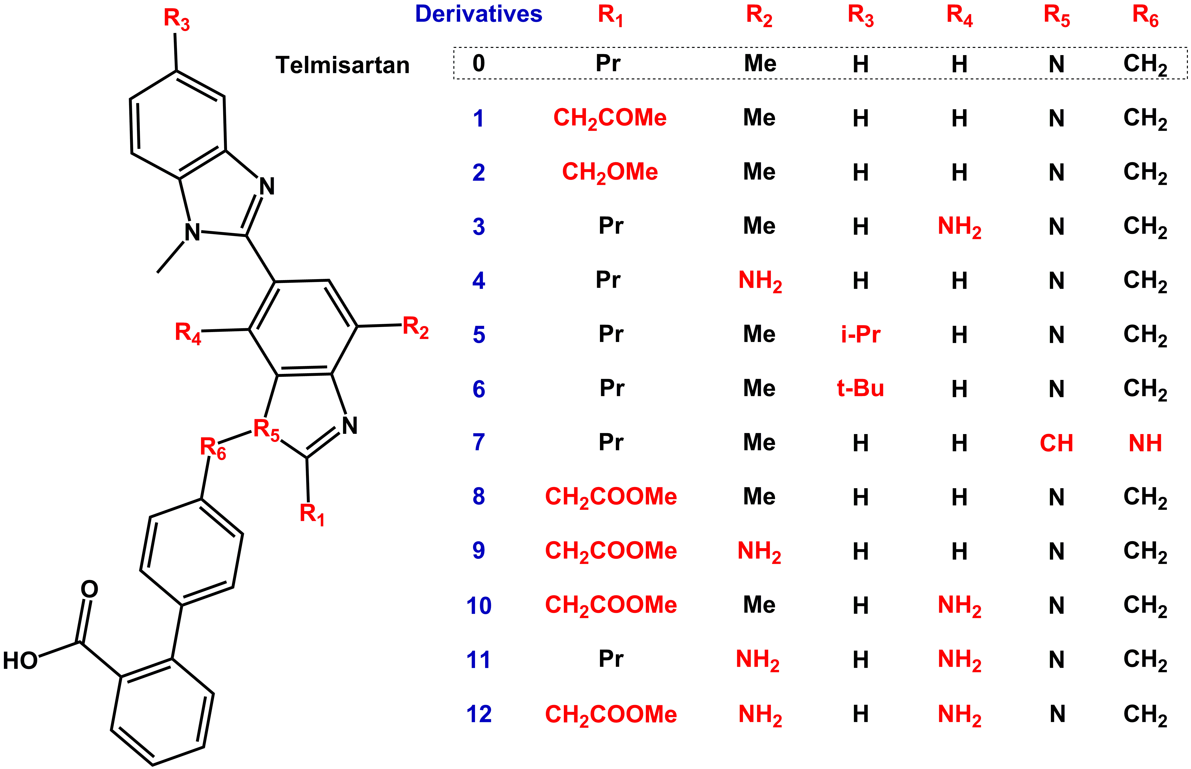
Protein Binding Site Based Drug Optimization
I154
V118
L11
L70
F106
N14
D56
D17
N69
V104
K21
Pr Me H H N CH₃
14 CH₂CH₂COMe Me H H N CH₂
Propyl-bisbenzimidazole

Slide 14
Specific Aims for the hackathon
1. Extract PLIP Contacts for any ligand bound to a protein chain from XML to JSON
2. Differential analysis of two different ligands bound to the same binding site
3. Create an iCn3D widget for protein-ligand interactions and differential analysis
4. Assign Force-Field based energies to the individual interactions identified by PLIP.

Slide 15
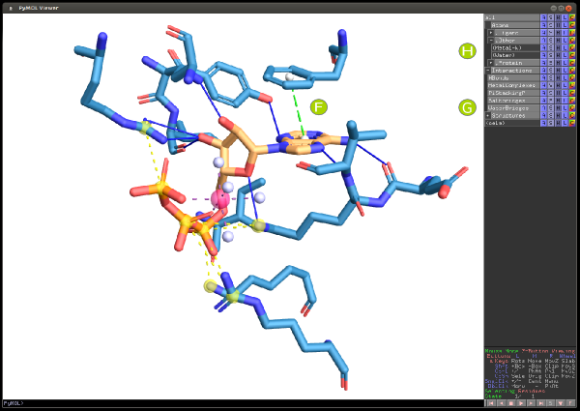
Tools/Databases available
PLIP Server
https://projects.biotec.tu-dresden.de/plip-web/plip
PDB
https://www.rcsb.org
AMBER-lite

Slide 16
Team 3A Tasks
1. Extract PLIP Contacts for any ligand bound to a protein chain from XML to JSON
2. Differential analysis of two different ligands bound to the same binding site
3. Create an iCn3D widget for protein-ligand interactions and differential analysis
4. Assign Force-Field based energies to the individual interactions identified by PLIP.
Team member name | Expertise | Tentative task assignment
Sreeranjini Babu | c/c++
Sridhar Malkaram | shell, python, R | 4, writer
Aaron Ayllon-Benitez | js, R, Python, C++, MySQL | 1,3
Rachita K Kumar | python, R, MySQL | 2
Sangram Keshari Sahu | shell, python, R, xml/json
Ravi Abrol | shell, python | 1,4, sys admin

Slide 17
Team 3A Schedule
Sat 7/11 – 4pm: First team meeting
Flextimes
Sun 7/12 – (12:30pm Our team only); 1pm: Teams-checkin meeting
Flextimes
Mon 7/13 – 1pm: Teams-checkin meeting
Flextimes
Tues 7/14 – 1:30pm: Final team presentations
Thur 7/16 – 12:50pm: Final project presentations at ISMB

Slide 18
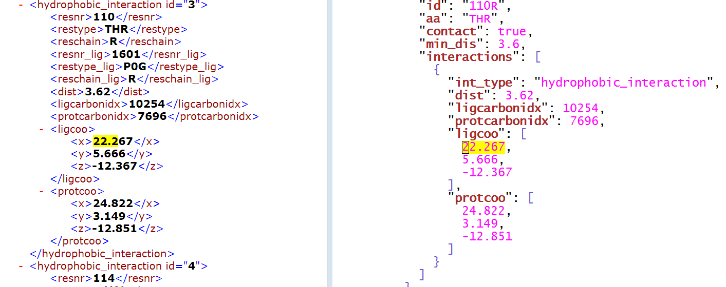
Workflow and Status
1. Extract PLIP Contacts for any ligand bound to a protein chain from XML to JSON
2. Differential analysis of two different ligands bound to the same binding site
3. Create an iCn3D widget for protein-ligand interactions and differential analysis
4. Assign Force-Field based energies to the individual interactions identified by PLIP.
Aim1: Aaron working on xml to json format conversion.
Aim2: Rachita will find PDBs for the same viral protein bound to two
different anti-viral drugs and write a code to do a differential analysis
of two interaction maps.
Aim3: We will plan this out after Jiyao’s widget demo.
Aim4: Aaron will generate a csv with interacting atoms and Sridhar
will use it for energy analysis.

